Slide 1
UNOFFICAL ACTIVITIES & PRIVATE ORGANIZATIONS
1 SOFSS NAF ACCOUNTING OFFICE
PO Coordinator: Mrs. Sydney James (McCabe)

Slide 2
Please sign in before you leave!
Slides will be sent to the email listed on the sign in sheet.

Slide 3
Order of Topics
Introduction to Air Force fundraising
The who, what, when, and where
What is an Unofficial Activities vs. Private Organization
Establishment/Operations – Three Areas of Requirement
Base – IAW AFI and other AF policies
State – IAW Florida State Law
Federal - IAW IRS regulations and other mandates
Fundraiser Request Process
Additional Rules & FAQs

Slide 4
Guidance
Guidance:
AFI 34-223 Private Organization (PO) Program, 13 Dec 2018
DAFI 36-3101 Fundraising, 26 Oct 2022
Air Force Services Agency 2019 Private Organization Guide

Slide 5
Who, What, When, Where, & Why
WHO can fundraise: Members of the Air Force or Federal Government, to include civilians, contractors (conditionally), Air Reserve and National Guard members and their dependents.
*You cannot approach contractors for contributions, but you may accept gifts should they make one.
Notes:
When planning holiday parties, it matters who is hosting. If the squadron, be careful raising funds through PO (AF cash gifts). If PO…easier for them to accept gifts from a UA.

Slide 6
Who, What, When, Where, & Why
WHAT can you fundraise for: Within the Air Force there are two options for fundraising:
1. Supporting an approved Federal campaign.
a. There are only two federally supported fundraising campaign: the Air Force Assistance Fund (AFAF) and the Combined Federal Campaign (CFC). These are annual campaigns facilitated at the federal level which offer installations and individuals the opportunity to get involved. Any fundraising events done in which 100% of the proceeds will be going to these programs can be classified and supported as an official duty activity. For more information on these programs please see DAFI 36-3101.
Notes:
When planning holiday parties, it matters who is hosting. If the squadron, be careful raising funds through PO (AF cash gifts). If PO…easier for them to accept gifts from a UA.

Slide 7
Who, What, When, Where, & Why
WHAT can you fundraise for: Within the Air Force there are two options for fundraising:
2. For the morale, welfare, or recreation (MWR) of an AF element.
a. All other fundraising within the AF, but not for the AFAF or CFC, cannot be supported at the federal level. Individual AF elements may seek out support via fundraising in the name of morale/welfare, but direct support from the DOD is incredibly limited and the handling of funds must be strictly regulated. For more information on these programs please see AFI34-223.
Notes:
When planning holiday parties, it matters who is hosting. If the squadron, be careful raising funds through PO (AF cash gifts). If PO…easier for them to accept gifts from a UA.

Slide 8
Fundraising for MWR
At the installation level, and certainly at the unit level, fundraising for the morale and welfare of those within the local base community is typically the most popular fundraising done day to day. Since this type of fundraising is not inherently supported like a federal campaign, authority to regulate these types of activities sits at the installation level. Such activities are divided across two programs that reflect whether fundraising is being conducted within an official or unofficial capacity.
Notes:
When planning holiday parties, it matters who is hosting. If the squadron, be careful raising funds through PO (AF cash gifts). If PO…easier for them to accept gifts from a UA.

Slide 9
Unit Unofficial Activities (UA)

Slide 10
Unit Unofficial Activities (UA)
Base-Level Fundraising in an Official Capacity – Unit Unofficial Activities
Fundraising within an official capacity outside the AFAF & CFC is extremely limited and therefore confined to the unit level. As a reminder – “official” in this case refers to fundraising that is permissible to be conducted on official duty status and preformed as a part of one’s service as an AF or Federal employee. Although the name may be a bit confusing, this program is referred to as Unit Unofficial Activities or UAs.
Notes:
When planning holiday parties, it matters who is hosting. If the squadron, be careful raising funds through PO (AF cash gifts). If PO…easier for them to accept gifts from a UA.

Slide 11
Unit Unofficial Activities (UA)
UAs are completely internal programs confined within their respective unit and are further restricted to only allow for the temporary storage of funds in an official capacity.
These funds must be used for future investments to enhance the welfare of squadron/unit members. This includes
your snack bar
burger burns
collecting money for special infrequent occasions (see Title 5 CFR, part 2635 Subpart C)
selling merch to unit members and dependents
And other MWR activities
These operations must be completely internal and are not to extend beyond squadron/unit personnel and their dependents (although there are special circumstances).

Slide 12
Unit Unofficial Activities (UA)
Unofficial unit fundraising, also known as “for us, by us,” is held to a monetary limit of $1,000 in monthly assets (think cash in the bank; not value of snacks in your snack bar) in order to facilitate funds being invested back into a squadron/unit.
UAs are not meant to facilitate large fundraising efforts which is why some decide to establish a private org.
Notes:
When planning holiday parties, it matters who is hosting. If the squadron, be careful raising funds through PO (AF cash gifts). If PO…easier for them to accept gifts from a UA.

Slide 13
UA Monthly Asset Limit
If your organization exceeds a monthly average of $1,000 over a 6-month period, your options are to:
Establish a Private Organization to assist with operations.
2. Discontinue on-base operations or reduce current assets.
This limit can be increased by $100 for every 50-unit members over 300, to a maximum of $5,000 monthly average .
Please be aware AAFES has priority for sustainment operations and does have authority to step in if snack bars exceed a certain limit.
Notes:
The $1000 does not include your on-hand inventory of non-cash items (ex: value of food in the snack bar).

Slide 14
Unit Unofficial Activities (UA)
The approving authority for UA events is the unit CC
They can approve internal fundraising events
There is no limit to the # of events, it is up to CC digression.
They have the right to request financials and meeting minutes regarding UA fundraising activities.
They control how information is disseminated with government channels.
If you would like to fundraise outside your unit you may do so but you will face the same restrictions as a private org and must seek FSS/CC approval on all events.
Notes:
When planning holiday parties, it matters who is hosting. If the squadron, be careful raising funds through PO (AF cash gifts). If PO…easier for them to accept gifts from a UA.

Slide 15
Private Organizations (PO)

Slide 16
Private Organizations (PO)
For those needing additional support they may elect to fundraise in an unofficial capacity, otherwise known as the Private Organization program.
Private Organizations (POs) are non-federal special interest groups that are allowed to operate on the installation with installation commander approval. POs choose to support DOD elements, but they are not part of the DOD – hence the unofficial or non-federal fundraising label.
Notes:
When planning holiday parties, it matters who is hosting. If the squadron, be careful raising funds through PO (AF cash gifts). If PO…easier for them to accept gifts from a UA.

Slide 17
Private Organizations (PO)
Because of this, it is not permissible to conduct any private org business in an official capacity as a DAF employee or on duty status. The result is that there are certain restrictions when it comes to what you can do on-base and in association to base:
Not authorized to use DOD content in relations to any activities.
Occasional on-base fundraising limit.
Restrictions when using official communication channels.
Notes:
When planning holiday parties, it matters who is hosting. If the squadron, be careful raising funds through PO (AF cash gifts). If PO…easier for them to accept gifts from a UA.

Slide 18
Using DoD Content
POs may not use:
The name, abbreviation, seal, or insignia of the Department of Defense, any military department, or Air Force Installation
Official Air Force, AFSOC, 1 SOW or individual unit letterhead
Unit names, office symbols, or anything of the like that implies official sponsorship
Rank or DOD contact info when completing signature blocks and/or paperwork.
Digital signatures permitted and preferred
All fundraiser participants must be off duty and out of uniform. Includes when hanging event flyers & speaking at CC’s call.

Slide 19
Occasional On-Base Fundraising Limitation
POs are only authorized for occasional on-base fundraising, defined as not more than 3 per quarter (based on the calendar year).
The occasional sales limitation for funding does not apply to unit unofficial activity or Private Organization sales of Air Force School or unit souvenirs, memorabilia to members of the school or unit involved.
SNACK BARS ARE A CONTINUOUS ACTIVITY AND THERFORE CANNOT BE RUN BY A PRIVATE ORG
UAs are intended only for the temporary holding of excess funds to be used directly for unit members/families. Cannot be funneled to a non-federal entity to include POs.

Slide 20
Private Organizations (PO)
However, it is this non-federal classification that allows PO’s the flexibility to:
- Fundraise outside a unit both on and off-base.
- Store any amount of funds as generated via approved methods.
Notes:
When planning holiday parties, it matters who is hosting. If the squadron, be careful raising funds through PO (AF cash gifts). If PO…easier for them to accept gifts from a UA.

Slide 21
Operation w/in the Unit
“For us, by us” fundraising authorized for UAs only.
Unit CC’s approval required
Operation On Base (Outside the Unit)
Available to UAs & POs
Requires FSS/CC approval
Operation Off Base
Available for POs only.
Requires FSS/CC approval

Slide 22
Consider which program is best for you! You can have one or the other, both, or none – it’s up to you.

Slide 23
Understanding Your Options
The cleanest method of year-round, large-scale fundraising for a sizable event (ex: holiday party) is to use a PO. Designed to raise money from sources other than your squadron’s member’s pockets.
Freedom to accept donations from outside sources
Ability to solicit (off-base only)
UAs can only fundraise in excess 6 months out, but they can still operate on base and with increased ease within the unit. Take advantage of that and use these funds for the day-to-day items.
Appropriately sized snack bar
Internal morale events w/ease (ex: burger burns, breakfast burritos)
Can consistently sell swag internally
Notes:
When planning holiday parties, it matters who is hosting. If the squadron, be careful raising funds through PO (AF cash gifts). If PO…easier for them to accept gifts from a UA.

Slide 24
Understanding Your Options
There are pros & cons to each…
POs can do a lot, but they are a lot of upkeep and may not be needed to accomplish your goals.
If you have questions about whether a PO is right for you, or potentially how to dissolve an existing org - please let me know.
You may find that you do not need a PO, and that’s okay!
Notes:
When planning holiday parties, it matters who is hosting. If the squadron, be careful raising funds through PO (AF cash gifts). If PO…easier for them to accept gifts from a UA.

Slide 25
QUESTIONS?
Last edited on 4/18/23 by Sydney McCabe

Slide 26
UA/PO ESTABLISHMENT: Base, State, & Federal Levels

Slide 27
Establishment
Area of Requirement:
Base Level – AFI Requirements for POs & UAs
State Level – Florida Dept of State; Revenue; Agriculture & Consumer Services Requirements
Federal Level – IRS Requirements
Running an organization that creates revenue requires a lot of coordination and approval. The base requirements are different for UAs vs. POs, but the processes for the State and Federal level will be the same.
The 1 SOFSS/FSR is required to maintain your base level approvals, but State and Federal is the responsibility of the organization.

Slide 28
UA Establishment – Base Level
Unit unofficial activities per AFI34-223 must at a minimum:
Maintain a two (2)-person accountability system for all cash transactions.
Submit basic annual financial report(s) to unit commanders detailing income and expenditures throughout the year.
If you would like an official “charter”, the 1 SOFSS/FSR can provide templates for:
Authority to Operate letter for unit commander signature
Constitution & Bylaws (primarily for state & federal use)

Slide 29
PO Establishment – Base Level
PO’s Responsibility
**Required w/C&B resubmission
Constitution & Bylaws**
Reviewed every two years or when there is a change of purpose, function, or membership eligibility
Request of Establishment
Insurance/ Waiver Request (negligible risk)
Even if waived, may still need insurance for specific events
Liability Certifications**
Members understand financial liability designated in C&Bs
List of Officers**
No ranks and non-DOD & DOD contact info!
Must have all positions filled.
Legal Review
Delegation of Authority to 1 SOFSS/CC
PO Authority to Operate Approval

Slide 30
PO Operation
Notes:
Most fall in first category and there is a template provided by FSR office.

Slide 31
PO Operation
**Based on a calendar year**
Quarterly Submissions
Quarterly Meeting Minutes
(Covers Jan-Mar, Apr-Jun, Jul-Sep, Oct-Dec)
Quarterly Financial Statements
(Covers Jan-Mar, Apr-Jun, Jul-Sep, Oct-Dec)
**Quarterly submissions are due
NLT 10 business days after the quarter ends
Notes:
There are template provided as well. More wiggle room with the meeting minutes, but please no official letterhead.

Slide 32
PO Operation
**Based on a calendar year**
Annual Submissions
Annual Report/Proposed Budget
List of Officers/POCs
Proof of taxes filed (if not exempt)
Two Year Submission
Constitution & Bylaws
**Annual submissions are due
NLT 20 business days after the quarter ends

Slide 33
PO Operation
When establishing PO operations please be aware you cannot use a base address. It is recommended a PO Box be established as private org business is not authorized to use base official mail channels.
A UA may use a base address but please make sure all letters are addressed with:
Recipient Name
Squadron/Unit
Address

Slide 34
Eglin Federal Credit Union
If you would like to open an account with Eglin Federal Credit Union, they will work with you to open a “Club” account. This is an option open to both UAs and POs.
You will be required to provide proof of eligibility to determine if you qualify for an account.
If you have issues, please reach out to FSR as this is a new arrangement with EFCU.
Notes:
There are template provided as well. More wiggle room with the meeting minutes, but please no official letterhead.

Slide 35
Eglin Federal Credit Union
To open an account, you will need:
$5 New Account Fee
To provide you UA/PO name.
Terms stating you are a non-profit (constitution & bylaws will suffice).
Your EIN (will discuss momentarily).
Documentation that you may operate on base.
If UA a MFR signed by unit CC.
If PO provide PO Authority to Operate letter and MFR signed by org President & PO Coordinator. MFR will need letterhead reflecting your private org.
All users requesting access must be present.
Notes:
There are template provided as well. More wiggle room with the meeting minutes, but please no official letterhead.

Slide 36
Eglin Federal Credit Union
To update an account, you will need:
Account #.
MFR with updated list of authorized users.
If UA must be signed by First Sergeant.
If PO must be signed by President & PO Coordinator.
MFR will need letterhead reflecting your private org.
All users requesting access must be present.
Notes:
There are template provided as well. More wiggle room with the meeting minutes, but please no official letterhead.

Slide 37
Establishment – State & Federal Level
Depending on the purpose of your organization, you will most likely be able to carry on to the State & Federal levels as a non-profit organization.
The nature of private orgs is typically to support the morale and welfare of a particular squadron/group.
If you are a religious or cultural group, you will certainly qualify.
If you fall under a non-profit parent organization you are most likely able to adopt their non-profit status as well if required to establish separately.

Slide 38
Establishment – State Level
Florida has no provisions for unincorporated/unregistered nonprofit associations, and therefore does not offer any protections to those acting on its behalf. This means there is no separate legal existence from its members and therefore they could be personally liable for its debts and liabilities.
Because of this, if you are wanting to operate a non-profit within the state of FL then you must incorporate.
This process requires a $70 fee and must be renewed annually from the date of initial registration.
Florida Non-Profit Corporation - Division of Corporations - Florida Department of State
Instructions: Instructions for Articles of Incorporation (FL Non-Profit) - Division of Corporations - Florida Department of State

Slide 39
Establishment – State Level
Before a non-profit can solicit in the state an organization must register with the Department of Agriculture and Consumer Services.
This can require a $10-$400 fee depending on org size and must be renewed annually.
Pay/Register Online / Home - Florida Department of Agriculture & Consumer Services (fdacs.gov)
Solicitation of Contributions / Business Services / Home - Florida Department of Agriculture & Consumer Services (fdacs.gov)
If an organization generates income from unrelated businesses or trades throughout the year (anything not mentioned within the constitution & bylaws), then they would have to file a Florida Corporate Income Tax Return.
F-1120
Florida Non Profit Filing Requirements | FL Annual Report (tax990.com)

Slide 40
Sales Tax Exempt Status
To exempt from Florida state sales tax a non-profit organization will need to apply with the Florida Department of Revenue.
You will need to complete a Consumer Certificate of Exemption Form DR-5 that must be reevaluated every 5 years.
Florida Dept. of Revenue - Sales Tax Exemption Certificates (floridarevenue.com)

Slide 41
Establishment – Federal Level
An organization must receive an Employer Identification Number (EIN) from the IRS in order to be recognized separately from its members.
This can be done for free online: Apply for an Employer Identification Number (EIN) online | Internal Revenue Service (irs.gov)
If you have an EIN in your records but are unsure of its status, you may search the IRS’s records here: https://apps.irs.gov/app/eos/

Slide 42
Establishment – Federal Level
Any revenue made, regardless of it is $5 or $5,000 must be reported to the IRS annually.
Any taxable income will be documented on a Federal Form 1120.
If any organization has existed/operated during years where revenue was made and not reported – they may be required to pay back taxes and face further punishments.
About Form 1120, U.S. Corporation Income Tax Return | Internal Revenue Service (irs.gov)
All form 1120s are due on April 15th. If you file late the IRS may incur penalties.
Instructions for Form 1120 (2023) | Internal Revenue Service (irs.gov)

Slide 43
Establishment – Federal Level
If an organization meets specific qualifications, they may apply to be federal tax-exempt with the IRS.
Applying for tax-exempt status | Internal Revenue Service (irs.gov)
This status allows for Federal Tax Exemption and for an organization to receive deductible contributions.
If you make less than $5,000 in annual revenue you can automatically operate as a non-profit without filing. Contributions made to you can be tax deductible, although businesses may prefer to see a written letter from the IRS.
If you make above this threshold you must apply for non-profit status otherwise all income is taxable and you must file an 1120 at the end of the year.

Slide 44
Establishment – Federal Level
POs and UAs may qualify as Charities & Non-Profits under the 501(c)(3) classification for federal tax exemption.
Every exempt charitable organization is classified as either public charity or private foundation under 509(a) that determines further IRS treatment:
Public charities have a broad base of support.
Private Foundations have a very limited source of support; small number of large donors.
Organizations at Hurlburt have been classified as both or neither... This determination is noted on the approval/rejection letter you will receive from the IRS.

Slide 45
Applying For Non-Profit Status
Before Applying
Gather your organization documents - primarily drafting your organization constitution and bylaws and incorporating with the state of Florida.
Obtain an employer ID number (EIN) for your new organization.
To apply
To request approval as a 501(c)(3) you will electronically complete Form 1023.
You will be required to select an identification code from the NTEE, or National Taxonomy of Exempt Entities.
Popular choice is W30 Military & Veterans’ Organization under Public & Societal Benefit
Applying for tax-exempt status | Internal Revenue Service (irs.gov)

Slide 46
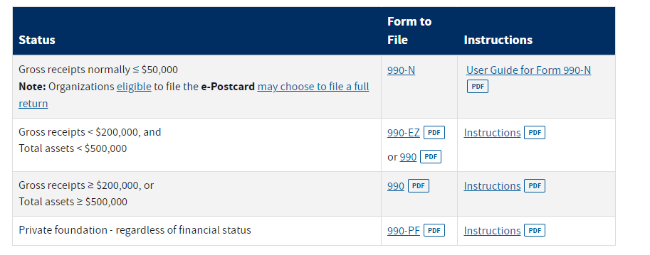
Keeping Non-Profit Status
To Maintain Status
Do not serve private interests or participate in any political or legislative lobbying.
Be sure to meet the annual filing requirements.
Annual filing and forms | Internal Revenue Service (irs.gov)

Slide 47
Keeping Non-Profit Status
Form 990s are due every year by the 15th day of the 5th month after the close of your tax year (usually the same as your accounting period).
Example: If your tax year ended on December 31, Form 990-N is due May 15 of the following year. If the due date falls on a Saturday, Sunday or legal holiday, the due date is the next business day.
A tax year is usually 12 consecutive months. There are two kinds of tax years:
Calendar Tax Year: This is a period of 12 consecutive months beginning January 1 and ending December 31; or
Fiscal Tax Year: This is a period of 12 consecutive months ending on the last day of any month except December.
Annual Electronic Notice (Form 990-N) for Small Organizations FAQs: When to File | Internal Revenue Service (irs.gov)

Slide 48
Keeping Non-Profit Status
Generally, your tax year (or accounting period) can be found in the following documents:
Your organization’s by-laws.
Your application for federal tax-exempt status (Form 1023 or Form 1024) or the determination letter you received approving your tax-exempt status.
The application, Form SS-4, your organization filed to obtain its employer identification number (EIN).
A copy of a prior year return, Form 990 or 990-EZ, that you filed with the IRS.

Slide 49
Keeping Non-Profit Status
Failure to meet the annual tax filing requirement for 3 years will result in automatic revocation.
An org may apply for reinstatement that could extend back to their revocation date.
For anytime your tax-exempt status is not active all income is taxable and you would be required to either file an 1120 or seek reinstalment.
To seek reinstatement: Automatic revocation of exemption | Internal Revenue Service (irs.gov)
To meet AFI requirements you must also send proof your org has filed annually to the 1 SOFSS/FSR.

Slide 50
Reporting Turnover/Changes
A Florida non-profit must report updates and keep information current. This can be adjusted on your organization’s Sunbiz.org account that will be create upon incorporation.
Update Your Information - Division of Corporations - Florida Department of State

Slide 51
Reporting Turnover/Changes
An exempt organization (EO) must report name, address and structural and operational changes to the IRS.
If an organization files an annual return (such as a form 990 or 990-EZ), it must report the changes on its return.
If the organization needs to report a change of name, see Change of Name- Exempt Organizations.
If it needs to report a change of address, see Change of Address - Exempt Organizations.
The EO Determinations Office can issue an affirmation letter showing an organization's new name and/or address and affirming the section of the Internal Revenue Code under which IRS records show the organization as tax-exempt and whether contributions to the organization are deductible.

Slide 52
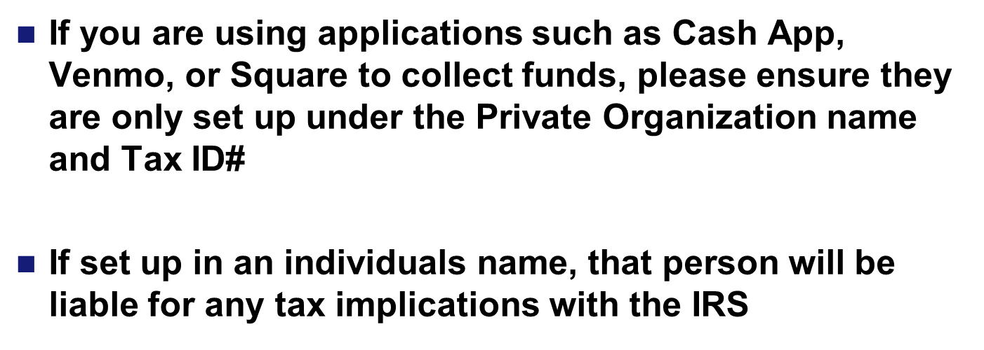
Third Party Payment Apps
**Reminder**

Slide 53
Establishment/Operation
**Orgs that remain in a non-compliant status will be referred to the MSG/CC for dissolution & could face State and Federal level repercussions**

Slide 54
QUESTIONS?
Last edited on 4/18/23 by Sydney McCabe

Slide 55
The Request Process

Slide 56
Fundraiser Request Process
Office: | Action: | Last Name/Rank/Date: | Remarks:
1 SOFSS/FSRF | Coordination
1 SOW/JA | Legal Review |  | *Two Week Process
1 SOFSS/FSRF | Coordination
1 SOFSS/FSR | Review
1 SOFSS/CSS | Review
1 SOFSS/CC | Signature
1 SOFSS/FSRF | Action
THIS IS A LONG PROCESS SO PLEASE PLAN ACCORDINGLY
We understand things can pop up quickly, but this is a combined effort across several offices - everyone is busy!
Allow a minimum of 3 weeks for approval but know this is not a guarantee.

Slide 57
Types of Requests
Fundraiser (Selling of items & services of value)
UAs & POs (UAs on-base only)
Can include solicitation for POs
3 per quarter on base
Solicitation (Seeking items or cash as a gift)
POs only
Must be off base
In-Kind Collection (Ex: Clothing & food drives)
UAs & POs (UAs on-base only)
Different from soliciting as requesting org is not benefiting
Free to attend events (ex: Heritage or Pride month events)
Event must still be reviewed and FSS/CC notified

Slide 58
Request Form
Go through the checklist:
Signatures?
Facility - Need supporting evidence (MFR, email traffic, contract/invoice, etc.)
Safety (850) 884 – 7233 - If you are unsure at all remember your org would be liable…
Fire Prevention (850) 884-2910 or 6715 - If you are handling any heating elements
Public Health (850) 881- 4756 - Anytime food or drink is involved, even if it is prepackaged/cooked.
Solicitation Letter? (if using)
Flyer/Advertisement(s)? (is using)
Menu w/Pricing? (if requested by 1 SOFSS/FSR)

Slide 59
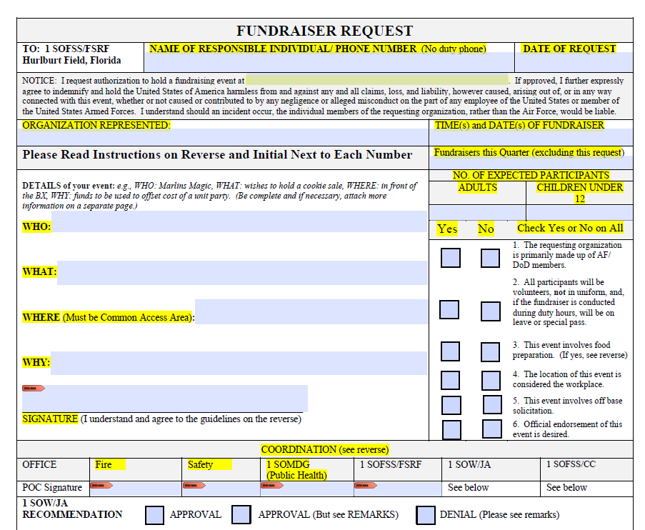

Slide 60
GUIDELINES (Please initial all)
_____1. Appropriate coordination and approval are required on all fundraising requests. Proper coordination procedures are listed below. Please note that DAFI 36-3101 severely limits fundraising during CFC and AFAF.
_____2. All fundraising activities must be coordinated through 1 SOW/CC (or delegate) and 1 SOW/JA. DoD 5500.7-R, AFI 34-223, and DAFI 36-3101 must be reviewed in addition to these instructions.
_____3. Private organizations (POs) must not do anything that implies federal endorsement of a fundraising event and members may not actively participate in fundraising while on duty, in uniform, or while at the workplace. All DoD members who participate in this event must do so with the clear understanding that they may only do so in their capacity as individuals. Civilian employees, like military members, are subject to the requirements of AFI 34-223, DAFI 36-3101 and the Joint Ethics Regulation (JER).
_____4. POs are prohibited from engaging in any conduct that has the effect of advertising for, making referrals to, or encouraging the use of any commercial business concerns.
_____5. POs may not conduct games of chance, lotteries, raffles, or other gambling-type activities other than those permitted by AFI 34-223. Unofficial activities (UAs) may not conduct games of chance, lotteries, raffles, or other gambling-type activities under any circumstances.
_____6. Fundraisers must be conducted away from the workplace. The installation commander determines which areas of the installation are and are not workplaces. DAFI 36-3101 provides examples. The requirement that fundraising not occur at the workplace is not affected by the military status of fundraisers.
_____7. Fundraisers may not involve frequent/continuous resale activities or compete with AAFES Services/NAFI activities.
_____8. Organizations are limited to three (3) fundraisers per quarter, and lengths of fundraisers are fact dependent.
_____9. Direct solicitations for gift donations on base is prohibited, but UAs may solicit limited monetary donations IAW DAFI 36-3101 and the JER.
_____10. Advertising may not occur until the fundraiser is approved. A copy of the advertisement must be included in the fundraiser packet for approval prior to dissemination. Advertisement shall not contain any official names belonging to the Air Force (such as unit names, office symbols, and rank). Additionally, the facility manager of the location of the fundraiser is required to approve any advertisement prior to posting flyers in buildings on base.
_____11. The JER prohibits the use of DoD communication resources or any other Government resource in any manner that would reflect adversely on the DoD, which specifically includes soliciting and selling (JER Sec. 2-301(a) and (b)). AFI 34-223, para. 11.1.3 states that “use of Government equipment and systems for other than official purposes is extremely limited.” POs and UAs shall not send base-wide emails to advertise the event. Advertisement of the event may not appear to be an official Air Force or Hurlburt Field endorsement of the event.
_____12. With prior approval, POs may solicit local businesses off base for donations or gifts. UAs are not allowed to solicit donations or fundraise off base. Organizations operating on the installation are prohibited from engaging in any conduct that has the effect of advertising for, making referrals to, or encouraging use of any commercial business.
_____13. Alcohol cannot be sold or served. Any fundraiser involving the sale or preparation of food must comply with AFI 48-116, Food Safety Program, and be coordinated with the Hurlburt Field Public Health Office.
_____14. This form must be kept on hand during the entire fundraiser.

Slide 61
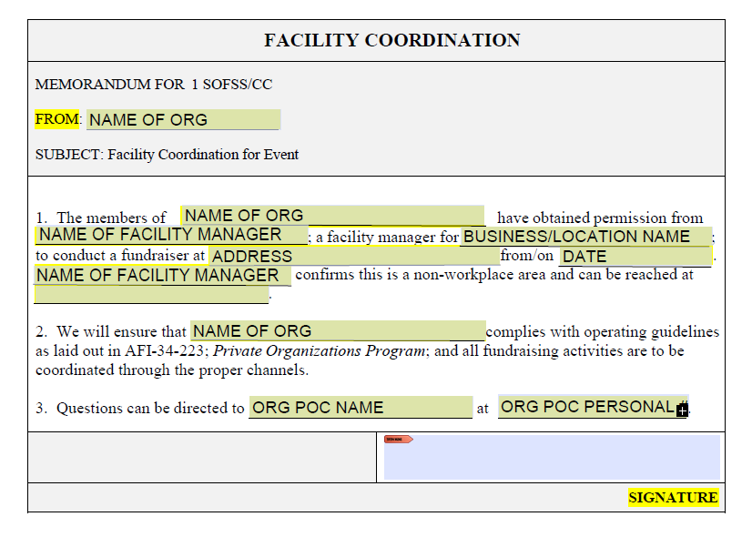

Slide 62
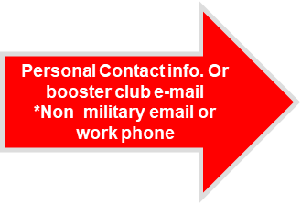
Flyer Sample
Booster Club Name
Not your Squadron
For more information contact: John Doe at 850-246-8910 or John.Doe@yahoo.com
“This is a private organization. It is not a part of the Department of Defense or any of its components and it has no governmental status.”

Slide 63
PO Fundraising/Solicitation
The use of Government equipment and systems for other than official use is extremely limited.
Acting as a concerned unit member, you may send emails via gov email only within your unit and with unit CC’s approval.
Events can only be disseminated as beneficial/enriching for DOD community. No mention of fundraiser, hosted by PO, or purpose. (ex: ‘Burrito Sale 20 Jan 23 at X location’)
These emails must originate from a source other than leadership. First Sergeant’s are an excellent option too!
If your email gets picked up by another unit, please be sure only event information is being passed along.

Slide 64
PO Fundraising/Solicitation
Please note that base wide emails are not always a viable option for Private Org fundraising. Public Affairs is limited in how they can assist POs.
Marketing in FSS facilities:
The FSS Marketing Department has advertising services (including the marquees) that POs may purchase. This is the only form of authorized advertising within FSS facilities. POs may receive free advertisement in the case of qualifying events (ex: Spouses Club hosts auction to raise money for scholarships for DOD dependents).
For questions/pricing please call #884-3821

Slide 65
Additional Rules & FAQs

Slide 66
Additional Rules
Organizations may not:
Solicit funds or donations from non-members on base
Sell alcoholic beverages*
Engage in activities that duplicate or compete with AAFES or FSS to include base wide event dates (also applies to UAs)
Conduct games of chance, lotteries, raffles, or other gambling-type activities (i.e. poker runs, etc.) except as provided in AFI 34-223, para 10.20. Unofficial activities may not engage in gambling type activities of any kind under any circumstances (also applies to UAs)

Slide 67
Fundraising During AFAF & CFC
During AFAF & CFC fundraising efforts should generally not interfere or detract from these federal campaigns.
Air Force Assistance Fund (Feb - June)
PO fundraisers held on-base will not be approved during this time unless invited to support an FSS event (Easter, Commando Games, Freedom Fest)
Combined Federal Campaign (Nov - Jan)
Ad hoc fundraising to support unit holiday parties is allowed during the CFC. If your on-base event is not supporting your holiday party during this time it will not be approved.
Limited workplace fundraising (desk-to-desk) by unit unofficial activates/social funds is still allowed. (AFI36-3101 5.1)

Slide 68
POs/UAs & Commercial Businesses
Commercial Sponsorship: The act of a non-Federal entity providing support to help finance or provide enhancements to service capabilities in exchange for promotional consideration and access to the Air Force market.
Commercial sponsorship is not authorized for private organizations or unit unofficial activities unless conducting an approved fundraiser through a third party (ex: art sale via contracted art dealer)
There are specific guidelines for the briefings that financial firms may give on base. If you are approached by a business offering these services, please contact the Airman & Family Readiness Center.

Slide 69
Receiving/Giving Gifts
POs may accept gifts and donations from outside sources, although recognition may not be made publicly- only oral recognition can be made to members of the org or those present at an event benefiting from the gift (no social media).
POs can donate to other POs and work together when hosting events
UAs are federal entities and must follow specific guideline regarding gifts. Cash gifts to the Air Force are not plausible at this level as approval authority sits with the Secretary of the Air Force.
Recommend interested parties donate good/services instead.
Notes:
When planning holiday parties, it matters who is hosting. If the squadron, be careful raising funds through PO (AF cash gifts). If PO…easier for them to accept gifts from a UA.

Slide 70
Receiving/Giving Gifts
NAFI are the only entities that can accept cash donations as NAF funds. This applies only to MWR elements within FSS & requires Wing/CC approval.
All other federal entities, including UA’s, can only accept gifts of tangible or intangible personal property of a certain amount with Installation Commander Approval (excludes cash).
Gifts from an outside entity, such as a PO, intended for Hurlburt Field Airmen (ex: golf tournament tickets, food, etc.) can be coordinated through the Public Affairs office.
Orgs can give gifts to federal employees and federal employees may accept it only if the gift is $20 or less.
Notes:
When planning holiday parties, it matters who is hosting. If the squadron, be careful raising funds through PO (AF cash gifts). If PO…easier for them to accept gifts from a UA.

Slide 71
Required Materials & POC
All updated forms and guidance can be found at: https://www.myhurlburt.com/pages/Private-Orgs.html
All documents and correspondence should be sent to: 1SOFSS.NAF.AO.ORG@US.AF.MIL
Current PO Coordinator: Mrs. Sydney James (McCabe)
(850) 884 - 2959
Notes:
The forms online may be slightly outdated (nothing we can’t work with) but should be fixed soon. Can reach out directly for forms.

